Slide 1
Tips and Tricks

Slide 2
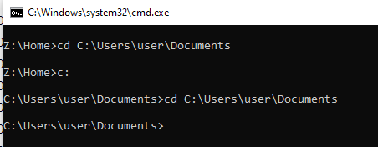

File Path Tips
In windows terminal, you can cd to that folder, by typing cd and then CTRL key + V key to paste the path you copied from Windows Explorer.
If your current path in Windows Explorer starts with a different letter to the path you copied from Windows Explorer, remember to switch to the same drive
For this example, notice I had to change to the C: drive from the Z: drive in order to cd to C:\Users\user\Documents!
Windows Explorer location bar has a nice feature to make it easy to nativate to the same folder in Windows Terminal
Click to the right of the last folder in the location bar (X marks the spot)
You can then copy the File Path using CTRL key + C key

Slide 3

Windows Terminal Tips
In windows Terminal you can use the arrow keys
The up and down arrows can be used to use previous commands
The left and right arrows can be used to edit a command in place.
The TAB key can be used for command completion.
For instance, I want to change to the Documents folder, I can type cd Do and then the TAB key and CMD will complete the command for me
CTRL key + V key can be used in Terminal to paste text you have previously copied

